Slide 1
Stack Overflow POS Tagger
Deheng YE
Aug. 2015

Slide 2
Some quick examples.
Which language is the most popular?
D N V R R A , -- determiner, noun, verb, determiner, adverb, adverb, adjective
While I would prefer python,
P N V V ^ , -- preposition, noun, verb, verb, proper noun, punctuation
You think perl is a better scripting language.

Slide 3
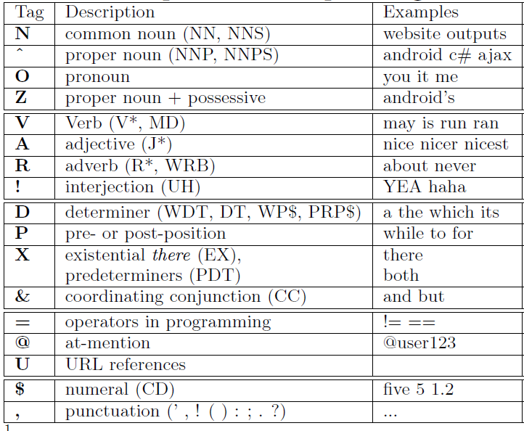
More examples.

Slide 4
Penn Treebank tagset -- a.k.a, PTB tagset
http://www.clips.ua.ac.be/pages/mbsp-tags

Slide 5
You are expected to take note when:
The tokenization is wrong.
E.g., the API printf() is ought to be one token, rather than 3 tokens – printf, (, and )

Slide 6
Open this server.
http://155.69.149.119/stackoverflow-annotator/pos.php?split=GroupTask1&from=0&to=100&perpage=100
Change GroupTask1 into “[your name]/[your name][TaskNo.]”
Your name = lijing, gaosa, chunyang, xuejiao, Lingfeng, Zhenchang – all in lower case
TaskNo. = 1 2 3 … 20

Slide 7
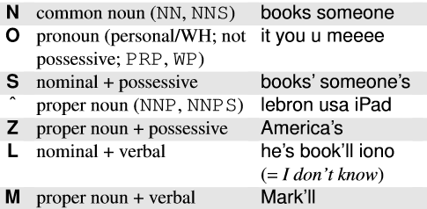
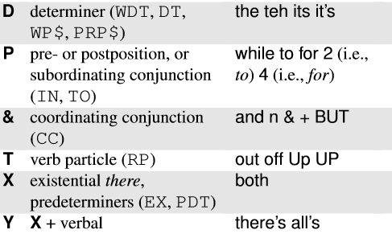
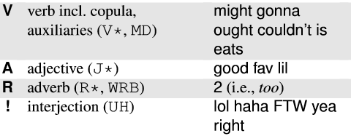
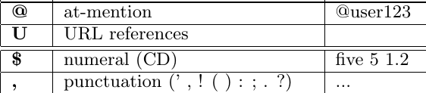
Cheat sheet.

Slide 8
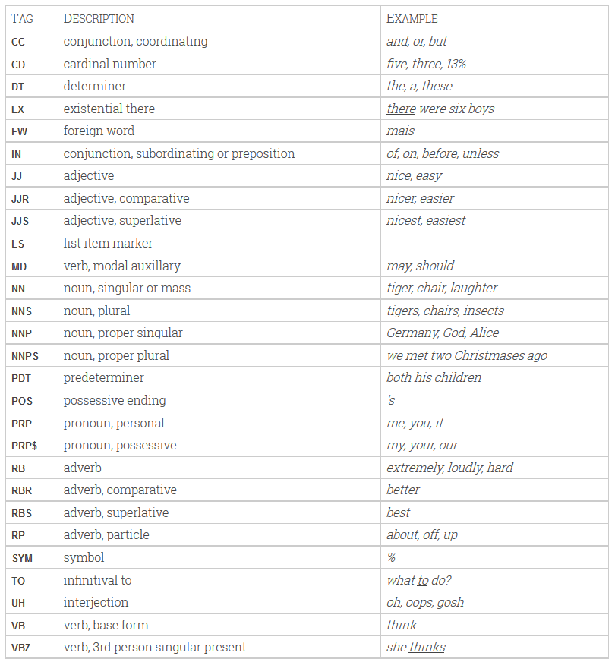
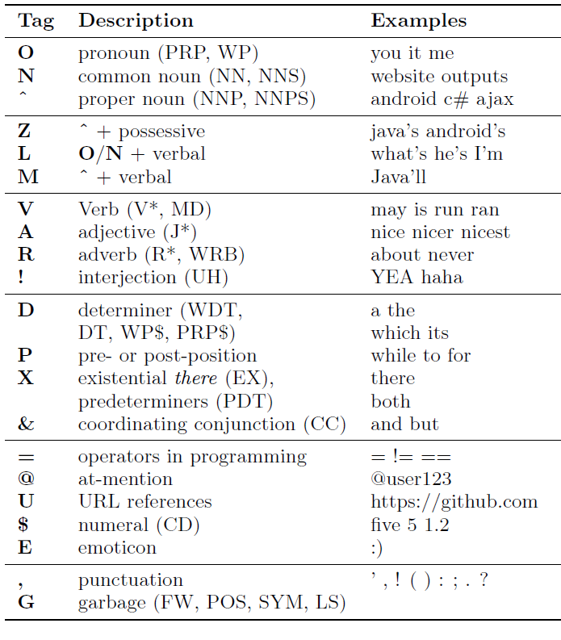
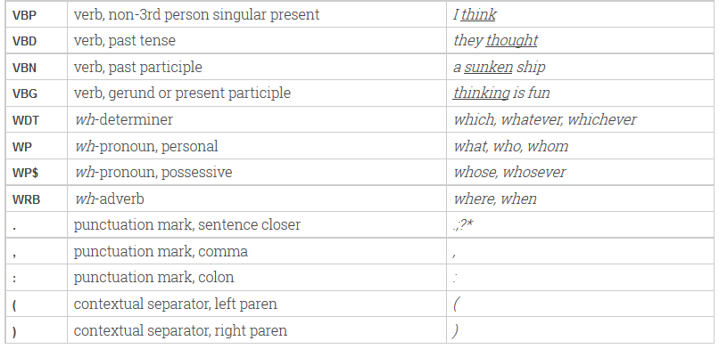
Our tagset
PTB tagset

